Slide 1


Slide 2
Agenda
What is AI?
What is machine learning?
What are the different types of machine learning?
What is over-fitting and under-fitting?
What are decision trees?

Slide 3

Why did HAL 9000 refuse to follow the order ?
“I am sorry Dave, I’m afraid I can’t do that”
- HAL 9000,
2001 - A Space Odyssey
(Directed by Stanley Kubrick)

Slide 4
For any machine to be called AI, it should either think or interact like humans do?
Can it interact with external world like humans?
General Purpose AI
General purpose context
Adaptive
Narrow / Limited context
Narrow AI
Think
Can it think like humans do?
Automation
Pre defined
Transactional
Context aware & natural
Interact
Notes:
Give reference of turing’s test : Fool a human being into interacting with another human,that machine can be called intelligent

Slide 5
AI systems should either think or interact like humans do?
Enabling Technologies
Machine learning (Reason)
Big Data technologies (Synthesize )
General Purpose AI
General purpose context
Adaptive
Narrow / Limited context
Sift Science (ML Fraud detection)
IBM Watson
HAL 9000
Narrow AI
Google Self Driving cars
Think
(Synthesize & Reason)
Can it think like humans do?
Robotic process automation
IPSoft Amelia
Automation
Enabling Technologies
Computer Vision (Observe)
NLP, Speech recognition (Communicate)
Pre defined
Runbook / Scripting
Transactional
Context aware & natural
Interact
(Observe & Communicate)
Can it interact with external world like humans?
Notes:
Jeopardy – Quiz show IBM watson defeated champions

Slide 6
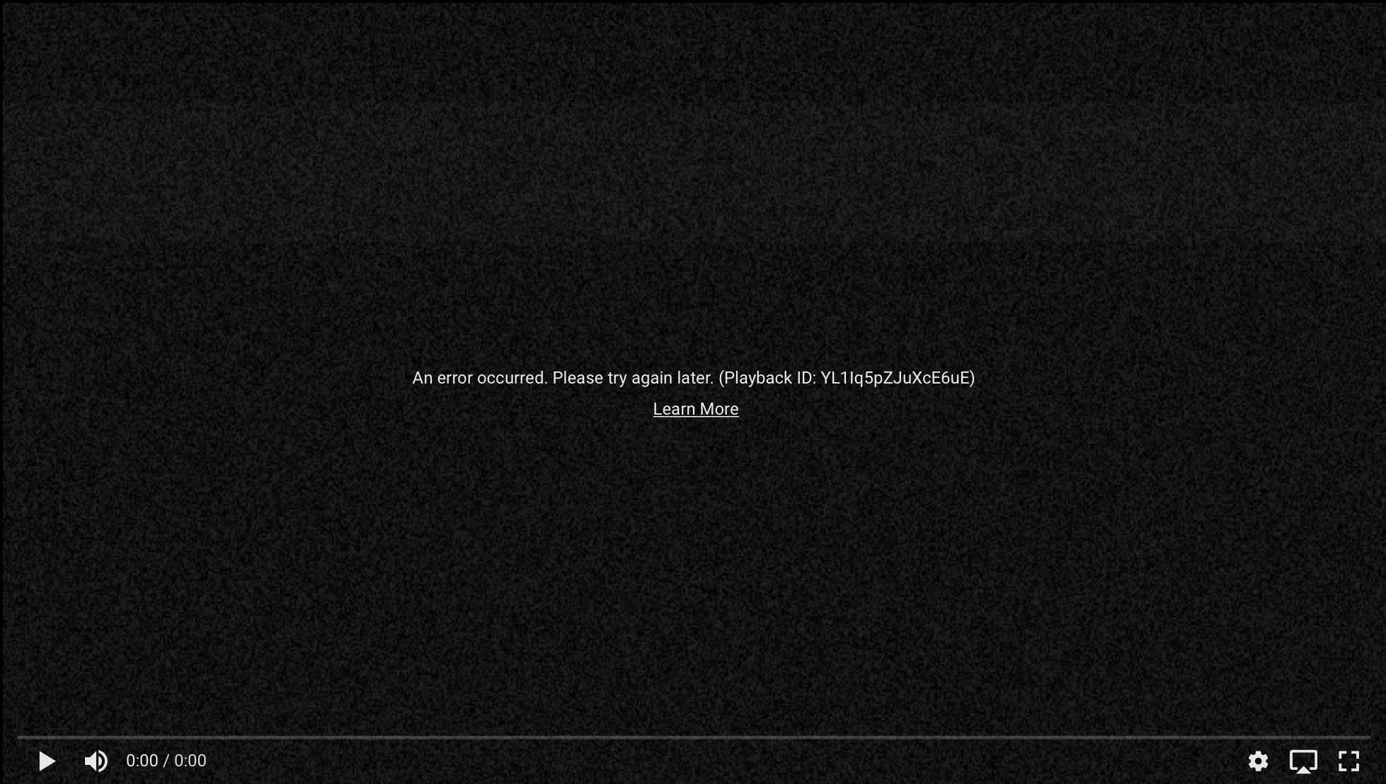
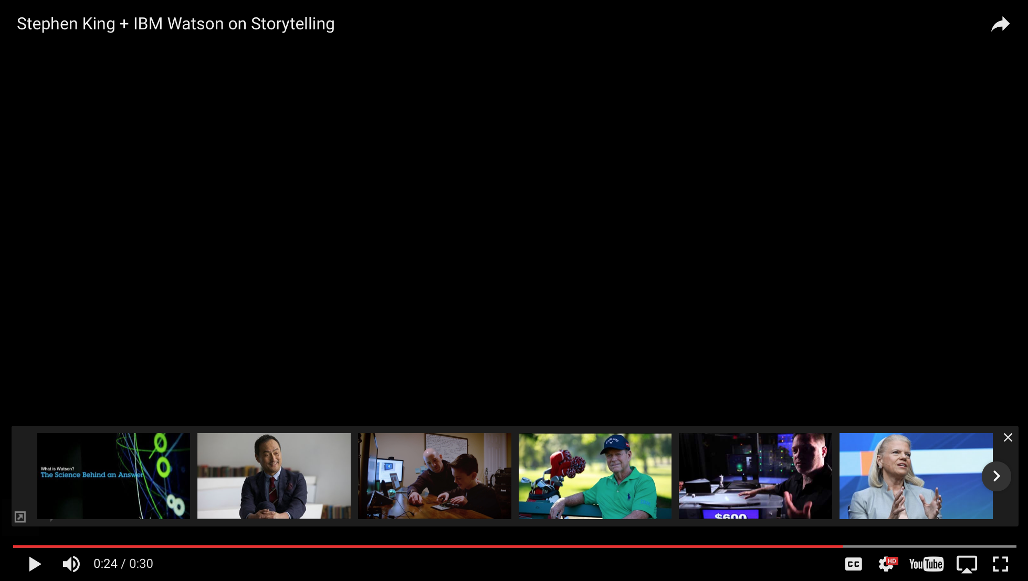
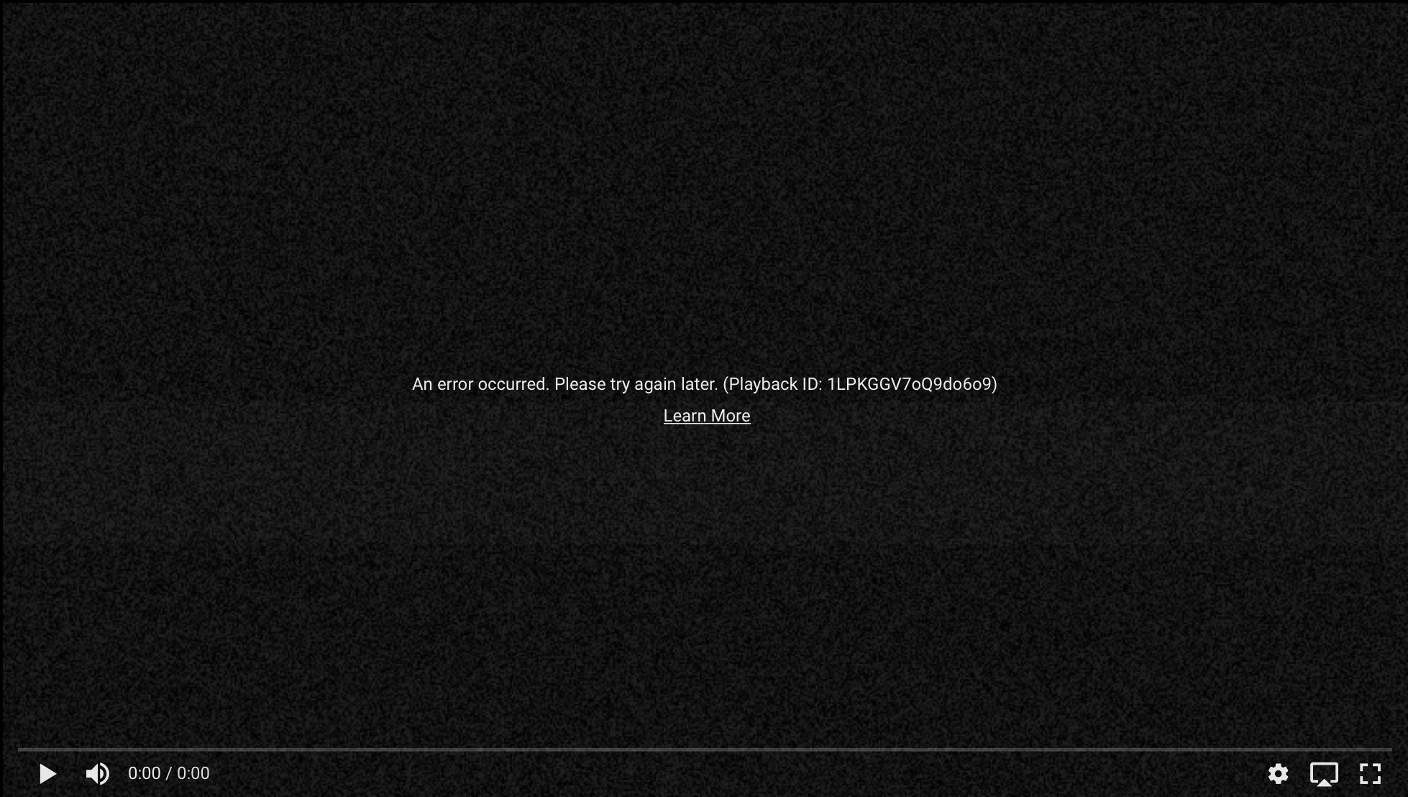
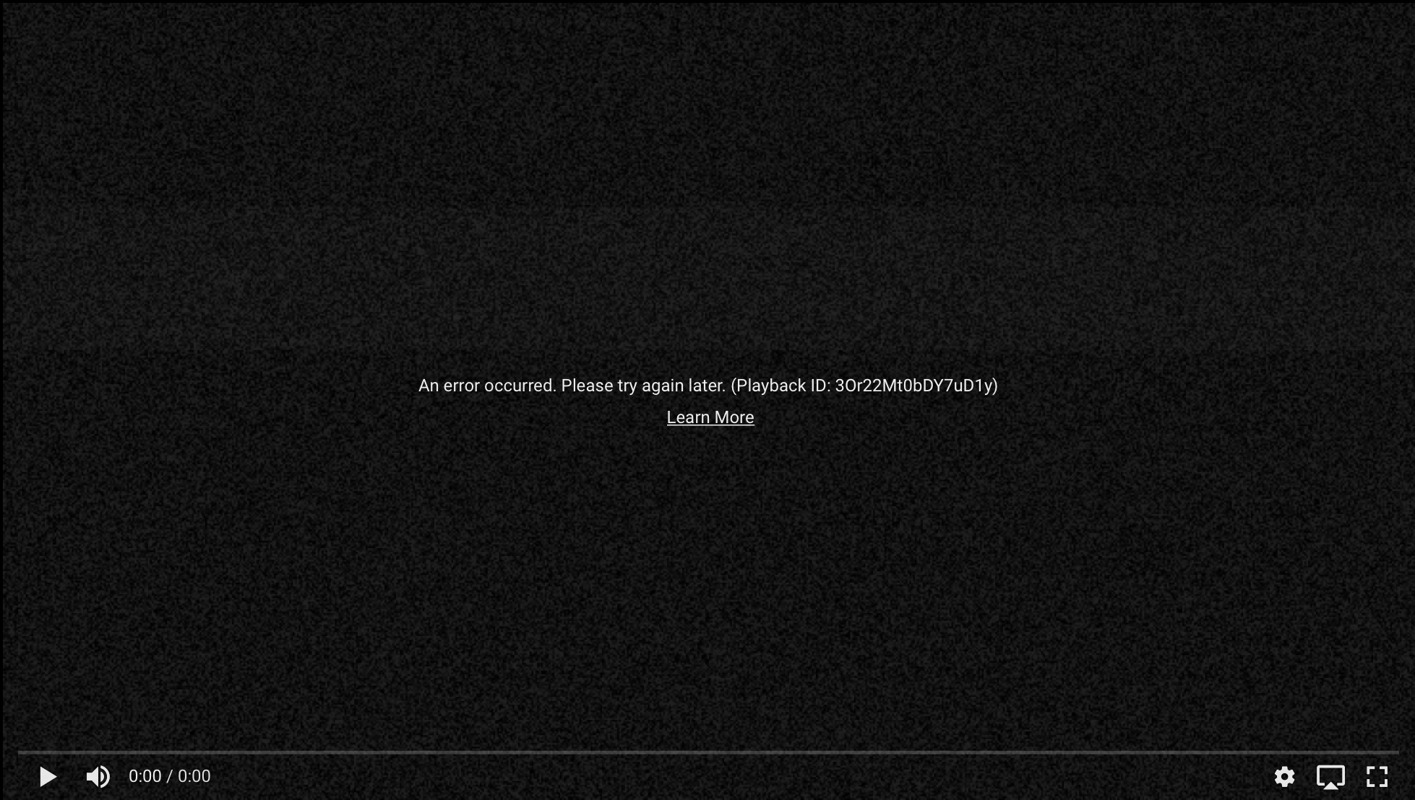

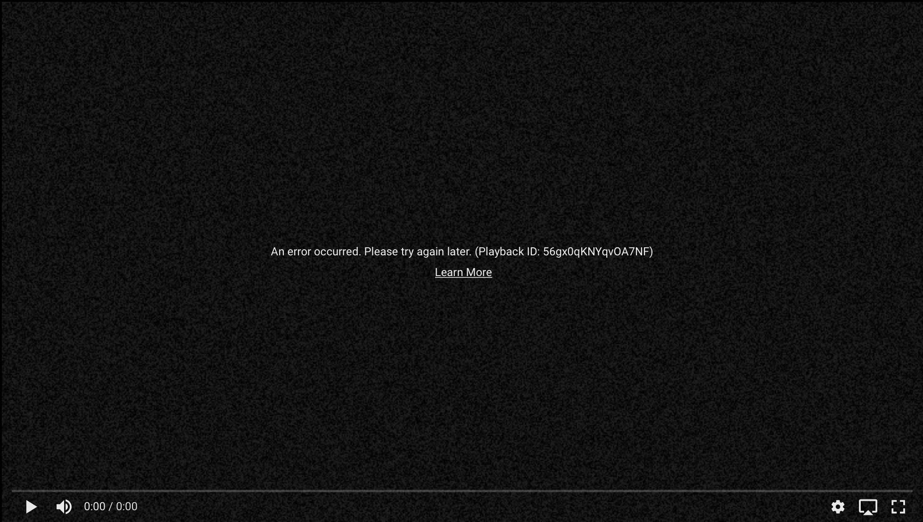
IBM Watson

Slide 7
Key Technologies enable interaction and communication
Big Data (Hadoop, Mapreduce, Nosql)
Automated content aggregation
Knowledge models and ontologies
Cloud processing
Knowledge graph traversal
Machine Learning algorithms
Deep Learning
Neural / Bayesian Networks
Genetic Algorithms
Sparse dictionary learning
Clustering
Decision tree learning
Planning, scheduling & optimization
Ontology based reasoning
Synthesize
Reason
Think
Observe
Communicate
Interact
Computer Vision
Facial / Object recognition
Eye / Gesture tracking
Speech recognition
Image recognition
3D reconstruction
GPUs
Sentiment Analysis
Natural Language Processing
Robotics
Virtual Reality
Q&A processing
Dialog management
Natural language generation
Gesture Control

Slide 8
For any machine to be called AI, it should either think or interact like humans do?
What is AI?
What is not?
Siri
IBM Watson
Self Driving Cars
RPA (Robotic Process Automation)
Computation
(Can it think like humans do?)
Reason
Probabilistic
Self Learning
Self Learning
Static
X
X
Synthesize
Information
Knowledge
Information / Knowledge
Unstructured data
OR
Interaction
(Can it interact like humans do?)
Observe
Context Aware
Context Aware
Context Aware
Context Aware
Communicate
Naturally
Naturally
Mechanical
Transactional
X
X
Can interact like human.
Can think like human.

Slide 9
What is machine learning?
Machine learning is a type of artificial intelligence (AI) that provides computers with the ability to learn without being explicitly programmed. Machine learning focuses on the development of computer programs that can change when exposed to new data. The process of machine learning is similar to that of data mining.
“A computer program is said to learn from experience E with respect to some class of tasks T and performance measure P,if its performance at tasks in T, as measured by P, improves with experience ”
- T.Mitchell(1997)
Notes:
In London

Slide 10
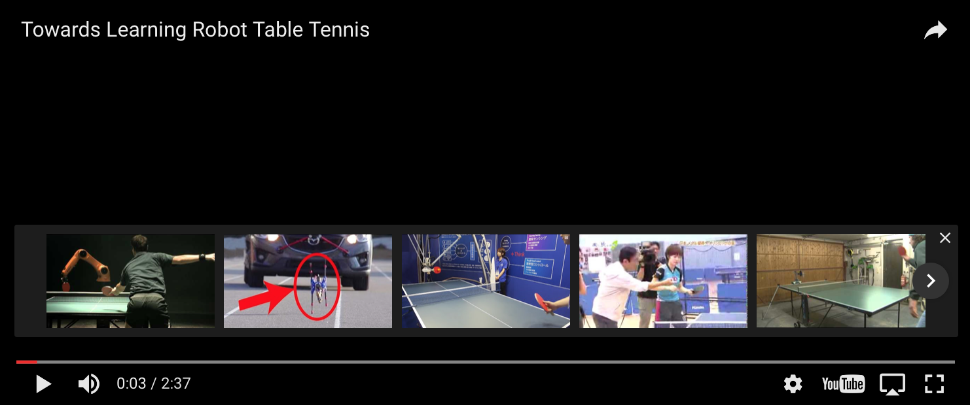
Towards learning robot table tennis

Slide 11
Types of machine learning
Supervised Learning
Unsupervised Learning
Reinforcement Learning
Makes machine learn explicitly
Data with clearly defined output is given
Direct feedback is given
Predicts outcome/future
Classification/Regression
Machine understands the data(Identifies patterns/structures)
Evaluation is qualitative or indirect
Does not predict or find anything specific
Reward based learning
Learning from +ve and –ve reinforcement
Machine learns how to act in a certain environment
To maximize rewards

Slide 12
Supervised Learning
Housing price prediction
400
300
Price ($) in 1000’s
200
100
0 500 1000 1500 2000 2500 3000
Size in square feet
Notes:
In London

Slide 13
Supervised Learning
Housing price prediction
400
300
Price ($) in 1000’s
200
Rights answers given
Regression - Predict continuous values output(price)
100
7500
0 500 1000 1500 2000 2500 3000
Size in square feet
Notes:
In London
N

Slide 14
Classification Problem
x2
x2
x1
x1
Notes:
In London

Slide 15
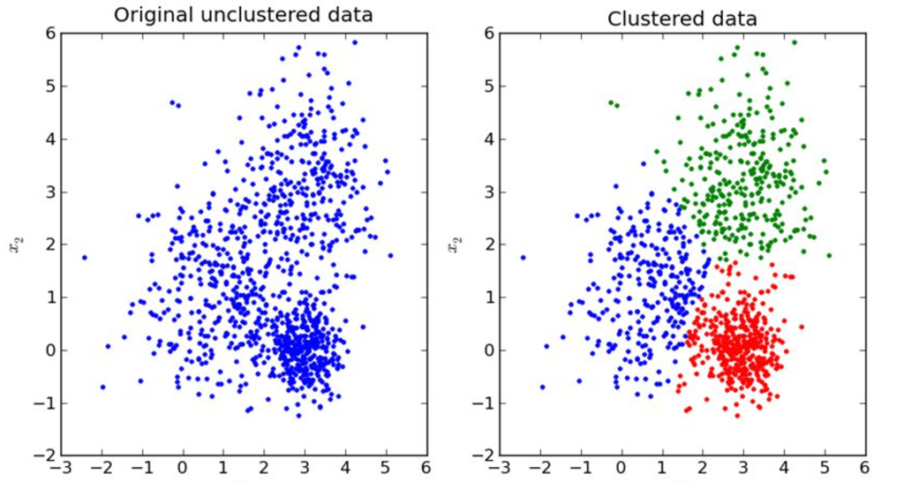
Unsupervised Learning
Given the data give me some description of data – Structure the data
Notes:
No one is telling u to how to divide,you know you have to divide,supervised learning tells exactly how to divide the world unsupervised no one does.
Clustering: Take a collection of 1,000,000 different genes, and find a way to automatically group these genes into groups that are somehow similar or related by different variables, such as lifespan, location, roles, and so on.
Non-clustering: The "Cocktail Party Algorithm", allows you to find structure in a chaotic environment. (i.e. identifying individual voices and music from a mesh of sounds at a cocktail party).
Reinforcement learning : Tic tac toe program getting better everytime it plays a tic tac ,reward could be a win.

Slide 16
Exercise
Suppose you have to predict whether sun will rise today, based on the trend that you know of for the past 2 months based on certain parameters. What kind of problem it is?
Classification/Regression?
Suppose you have patient history based on age, race and other parameters it is known whether the a tumor was cancerous or benign. Given a patient with a tumor predict whether he/she has cancer or not
Suppose you are working on stock market prediction, and you would like to predict the price of a particular stock tomorrow (measured in dollars). You want to use a learning algorithm for this. Would you treat this as a classification or a regression problem?
Notes:
In London

Slide 17
Generalization
The whole point of machine learning is generalization.
Generalization usually refers to a ML model's ability to perform well on new unseen data rather than just the data that it was trained on. It is strongly related to the concept of overfitting. If your model is over fitted then it will not generalize well.
Notes:
The ability of the learned model to fit unseen instance.

Slide 18
Generalization
Notes:
In London

Slide 19
Inductive Bias
The theoretical assumption that must be added to transform the algorithm's outputs into logical deductions.

Slide 20
Decision Tree Learning
Decision tree learning uses a decision tree as a predictive model which maps observations about an item (represented in the branches) to conclusions about the item's target value (represented in the leaves). It is one of the predictive modelling approaches used in statistics, data mining and machine learning. Tree models where the target variable can take a finite set of values are called classification trees; in these tree structures, leaves represent class labels and branches represent conjunctions of features that lead to those class labels. Decision trees where the target variable can take continuous values (typically real numbers) are called regression trees.
Notes:
In London

Slide 21
Decision Tree

Slide 22
Exercise
Create a decision tree for the concept “PlayGolf” .An example is classified by sorting it through the tree to the appropriate leaf node ,then returning the classification associated with this leaf (in this case yes/no).This tree classifies Saturday mornings according to whether they are suitable for playing golf or not.
Create a decision for choosing a restaurant on an evening for a date.
Notes:
Outlook/Humidity/Wind
Alternative/Bar/Veg Non veg/hungry/Cuisine/Price

Slide 23
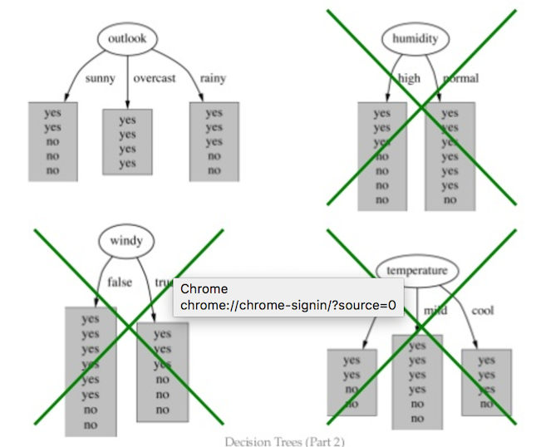
Play golf

Slide 24
Applications in Expedia

Slide 25
Homework
What is decision tree pruning?
What are random forests?
How are entropy and information gain calculated mathematically?

